Slide 1


Slide 2
INTRODUCTION TO
NUMPY

Slide 3
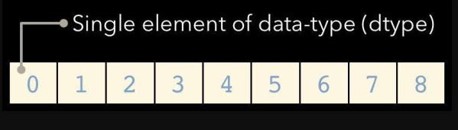
What is NumPy?
The NumPy library is the core library for scientific computing in Python.
It provides a high performance multidimensional array object and tools for working with these arrays.
The key to NumPy is the ndarray object, an n-dimensional array of homogeneous data types, with many operations being performed in compiled code for performance.

Slide 4
What is NumPy?
There are several important differences between NumPy arrays and the standard Python sequences:
NumPy arrays have a fixed size. Modifying the size means creating a new array.
NumPy arrays must be of the same data type, but this can include Python objects.
More efficient mathematical operations than built-in sequence types.

Slide 5
import numpy as np
A=[[1,2,3],[4,5,6]]
print(A)
type(A)
A = np.array(A) print(A) type(A)
Output:
[[1, 2, 3], [4, 5, 6]]
list
Output:
[[1, 2, 3], [4, 5, 6]]
list

Slide 6
Ans : ?
print(np . ndim(A))

Slide 7
print(np . ndim(A))
Ans : 2
print(np. shape(A))
Ans : ?

Slide 8
print(np . ndim(A))
Ans : 2
print(np. shape(A))
Ans : (2,3)
rows = np.shape(A)[0] columns = np.shape(A)[1]
print("number of rows = ",rows) print("number of columns = ", columns)
Output:
number of rows = 2 number of columns = 3

Slide 9
import numpy as np
a = np.arange(15).reshape(3, 5) print(a)
Ans:
[[ 0 1 2 3 4]
[ 5 6 7 8 9]
[10 11 12 13 14]]
print(a.ndim) print(a.shape) print(a.dtype.name) print(a.itemsize) print(a.size)
b = np.array([6, 7, 8]) print(b)
type(b)
2
(3, 5)
int64
8 15
[6 7 8]
numpy.ndarray

Slide 10
Array Creation
a = np.array([2,3,4])
print(a) a.dtype
[2 3 4]
dtype('int64')
b = np.array([1.2, 3.5, 5.1])
print(b) b.dtype
[1.2 3.5 5.1]
dtype('float64')
array transforms sequences of sequences into two-dimensional arrays, sequences of sequences of sequences into three- dimensional arrays, and so on.
b = np.array([(1.5,2,3), (4,5,6)]) [[1.5 2. 3. ]
print(b) [4. 5. 6. ]]

Slide 11
[[1.+0.j
3.+0.j
The type of the array can also be explicitly specified at creation time:
c = np.array( [ [1,2], [3,4] ], dtype=complex ) print(c)
2.+0.j]
4.+0.j]]
c=np.array([1,2,3,4,5,6,7,8,9,10]) | [ 1 2 3 4 5 6 7 8 9 10]
print(c)
D=np.reshape(c,(2,5)) | [[ 1 2 3 4 5]
print(D) | [ 6 7 8 9 10]]

Slide 12
The elements of an array are originally unknown, but its size is known.
Hence, NumPy offers several functions to create arrays with initial placeholder content. These minimize
the necessity of growing arrays, an expensive operation.
The function zeros creates an array full of zeros, the function ones creates an array full of ones, and the function empty creates an array whose initial content is random and depends on the state of the memory. By default, the dtype of the created array is float64.
[[0. 0. 0. 0.]
[0. 0. 0. 0.]
print(np.zeros( (3,4) ))
[0. 0. 0. 0.]]
[[[1 1 1 1]
[1 1 1 1]
[1 1 1 1]]
print(np.ones( (2,3,4), dtype=np.int16 ) )
[[1 1 1 1]
[1 1 1 1]
[1 1 1 1]]]
print(np.empty( (2,3) ) )
[[1.39069238e-309 1.39069238e-309 1.39069238e-309] [1.39069238e-309 1.39069238e-309 1.39069238e-309]]

Slide 13
To create sequences of numbers, NumPy provides a function analogous to range that returns arrays instead of lists.
np.arange( 10, 30, 5 )
[10, 15, 20, 25]
np.arange( 0, 2, 0.3 )
[ 0. , 0.3, 0.6, 0.9, 1.2, 1.5, 1.8]
When arange is used with floating point arguments, it is generally not possible to predict the number of elements obtained, due to the finite floating point precision. For this reason, it is usually better to use the function linspace that receives as an argument the number of elements that we want .
from numpy import pi print(np.linspace( 0, 2, 9 ))
x = np.linspace( 0, 2*pi, 100 )
print(x)
f = np.sin(x) print(f)
Ans: ?

Slide 14
Basic Operations
Arithmetic operators on arrays apply elementwise.
A new array is created and filled with the result.
a = np.array( [20,30,40,50] ) print(a)
b = np.arange( 4 ) print(b)
Ans: ?
c = a-b
print(c)
print(b**2) print(10*np.sin(a)) print(a<35)

Slide 15
Unlike in many matrix languages,
the product operator * operates element wise in NumPy arrays.
The matrix product can be performed using the @ operator (in python >=3.5) or the
dot function or method
A= np.array( [[1,1],
[0,1]] )
print(A)
B = np.array( [[2,0],
[3,4]] )
print(B)
Ans: ?
print("The Element wise product")
print(A * B)
print("The Matrix Product") print(A @ B)
print("The Matrix Product using dot function")
print(A.dot(B))

Slide 16
a=np. array([1,2,3])
b=np.array([(1.5,2,3),(4,5,6)],dtype=float)
c=np. array([[(1.5,2,3),(4,5,6)],[(3,2,1),(4,5,6)]], dtype=float)
print("The 1D",a)
print("The 2D",b)
print("The 3D",c) d=np.arange(10,25,5) print(d)
e=np. full((2,2),7) print("The full array") print(e)
f=np. eye(3)
print(“The 3 *3 identity matrix") print(f)
print("the random array") print(np.random.random((2,2)))
Ans: ?

Slide 17
print("The subtraction of a& b :”) print(np.subtract(a,b))
Also try comparison operations
Similarly try
a == b
np.add(b,a)
a < 2
np.divide(a,b)
np.array_equal(a,b)
np.multiply(a,b)
np.exp(b) np.sqrt(b) np.sin(a)
np.cos(b)
np.log(a)

Slide 18
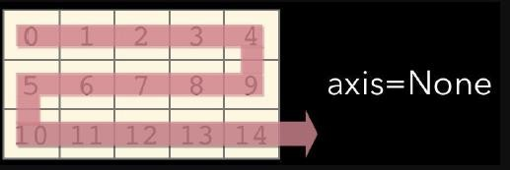
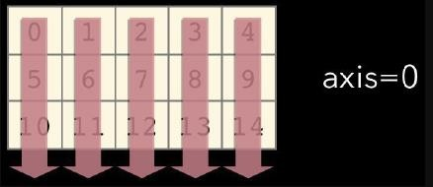
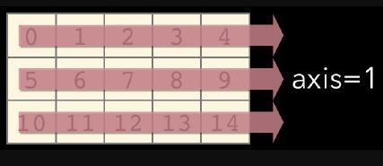
Aggregate Functions
print(b.sum())
print(np.sum(b))
Similarly try
a.sum()
a.min() b.max(axis = 0)
b.cumsum(axis = 1) a.mean() b.median() a.corrcoef() np.std(b)
Ans: ?

Slide 19
Copying Arrays
h=a.view() print(h)
C=np.copy(b)
print(C)
h=a.copy()
print(h)
Sorting Arrays
b=np.array([5,7,2,4,1,9,6,0])
print(b) print(np.sort(b))
a.sort() c.sort(axis=0)

Slide 20
Subsetting
1 | 2 | 3
a=np. array([1,2,3])
b=np.array([(1.5,2,3),(4,5,6)],dtype=float)
1.5 | 2 | 3
4 | 5 | 6
a[2]
b[1,2]
1 | 2 | 3
1.5 | 2 | 3
4 | 5 | 6

Slide 21
Slicing
a[ 0 : 2 ]
a[ : : -1 ]
b[ 0 : 2 ,1 ]
1 | 2 | 3
3 | 2 | 1
1.5 | 2 | 3
4 | 5 | 6
1.5 | 2 | 3
4 | 5 | 6
b[ : 1 ]
b[ : 2 ]
1.5 | 2 | 3
4 | 5 | 6

Slide 22
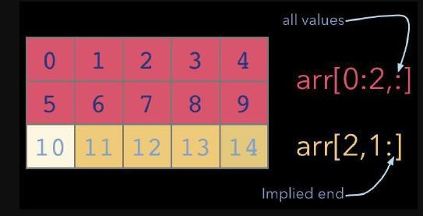
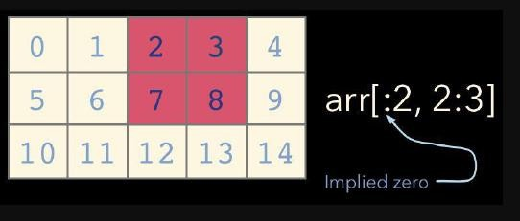
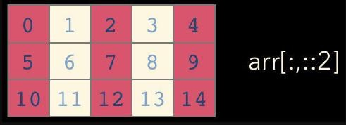
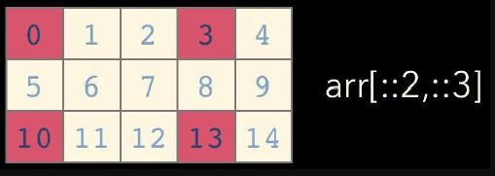
Ans: ?

Slide 23
Indexing
a[a<2]
b[[1,0,1,0],[0,1,2,0]]
b[[1, 0, 1, 0]] [:,[0,1,2,0]]
1 | 2 | 3
[ 4. 2. 6. 1.5 ]
[[ 4. 5. 6. 4. ]
[1.5 2. 3. 1.5]
[4. | 5. | 6. | 4. ]
[1.5 | 2. | 3. | 1.5]]

Slide 24
Transposing
i = np.transpose(b) print(i)
i.T
Changing Array Shape
b.ravel()
Flatten the array
g.reshape(3,-2)
Reshape, but don’t change data
[[-0.5 0. 0. ]
[-3. -3. -3. ]]
array([[-0.5, 0. ],
[ 0. , -3. ],
[-3. , -3. ]])
After reshape

Slide 25
A = [[1,2,3],[4,5,6]]
print(A)
type(A)
A = np.asarray(A)
print(A)
type(A)
print("Maximum element is ",np.max(A))
print(np.min(A)) print(np.mean(A)) print(np.median(A)) print(np.std(A))
B = np.transpose(A)
print(B)
C = np.reshape(A,(1,6)) print(C)
rows = np.shape(C)[0]
columns = np.shape(C)[1] print("number of rows = ",rows) print("number of columns = ", columns) print(A[0])
print(A[:,0])
print(A[:,1])
print(A) print(A[:,0])
print(A[:,1])
print(A[:,2])
print(np.sum(A[:,0]))
print(np.sum(A[0,:]))

Slide 26


